Slide 1
Sanjay S Bachelor of engineering Electronics and communication engineering Raja Rajeswari college of engineering
Smart Agriculture System Based on IoT
Overview of the project
In IoT based smart farming, a system is built for monitoring the crop field with help of sensors such as light, humidity, soil moisture and automating the irrigation system. The farmers can monitor the field conditions from anywhere. IoT –based smart farming is highly efficient when compared with conventional approach. In terms of environmental issues , IoT-based smart farming can provide great benefits including more efficient water usage, or optimization of inputs and treatments. Hence there is need to use innovative technology which we get in IoT.

Slide 2
Smart Agriculture Based on IoT
Technology used
Technology used in this project is based on the Internet of things . The purpose aims at making agriculture smart using automation and IoT technologies . The highlighting features of this include smart irrigation with smart control based on real time field data. The moto is to solve the problem of water irrigation in many areas and fields where the farmer can able to irrigate at one place and receive the data weather forecasting . Proper knowledge on using the application and the smart phone through The project in more efficient manner is done . The model is developed in such a way that it can provide the average result for irrigating of the plants and crops grown instead of real time data for a specific areas of land

Slide 3
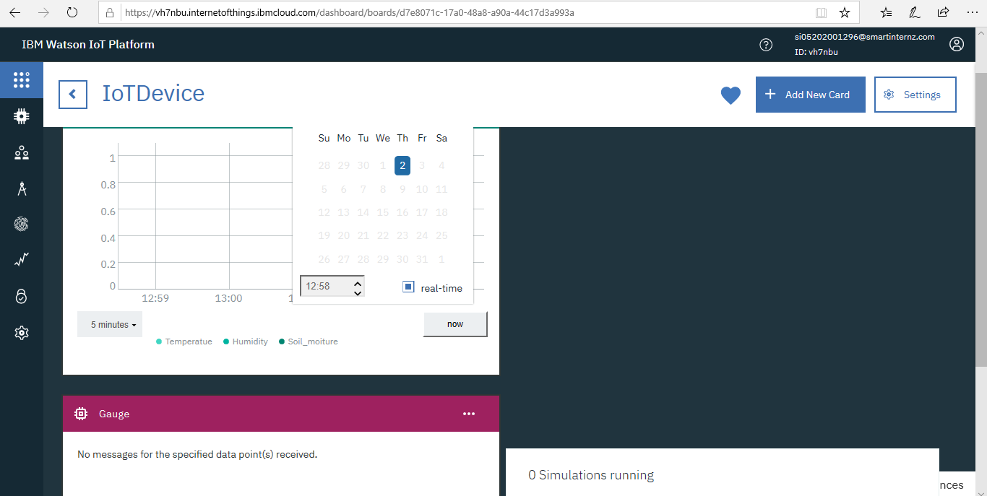
Hardware Designing
IoT Hardware Designing includes Watson IoT platform is managed, cloud-hosted service designed to make it simple to derive value from our IoT devices . Watson IoT has blockchain services and analytic service which enables to capture and discover the data for the devices. And machines are informative and useful in decision making . Hardware designing valuable are identified and for the environmental conditions such as temperature , humidity and object temperature and events are made to run and viewed through the graphical representations.

Slide 4
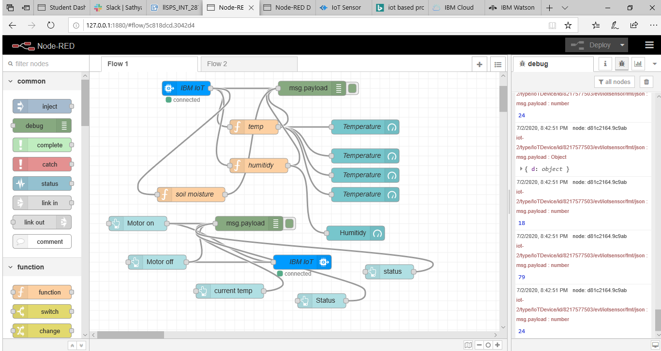
Software Designing
Software designing includes IBM Watson cloud platform and IoT IBM platform which is connected to web app where the motor is controlled by motor on and motor off and in turn it is connected to open Weather API through HTTP networking protocols. The web app includes the node red and python part where in the node-red the flow is built by using the nodes and user interface is created and commands is given and this commands is retrieved in the python code execution by connecting the device by giving device information while coding .

Slide 5
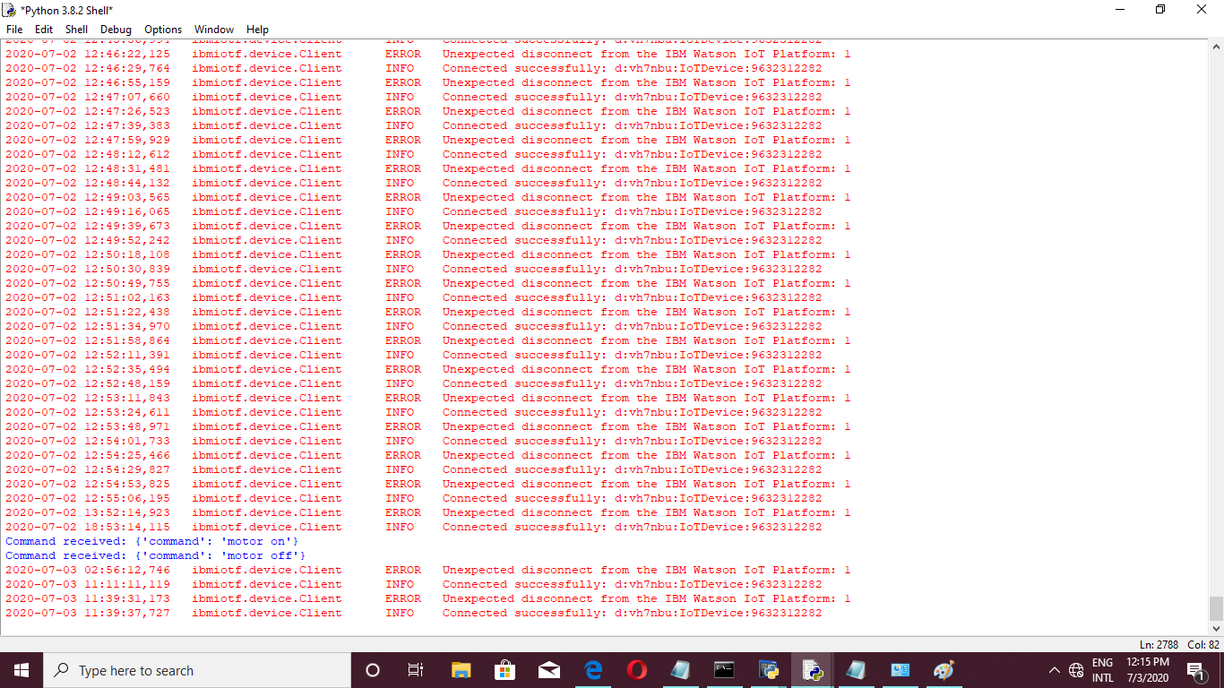
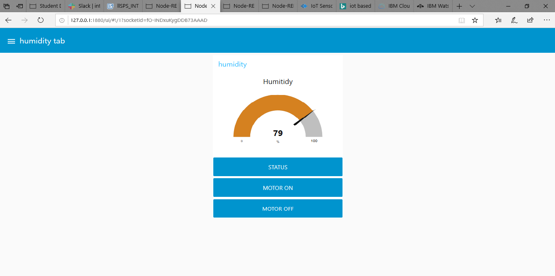
Result the result obtained is a smart agriculture which is farmer friendly and IoT based Smart Farming improves the entire agriculture system by monitoring the field in real-time. With the help of sensors and interconnectivity, the internet of things in agriculture has not only saved the time of farmers but has also reduced the extravagant use of resources.

